Slide 1
Geometric Deep Learning Unifying Neural Networks with Geometric Symmetries
EE Machine learning reading group
Keyue Jiang
Might be a long talk… But let’s see

Slide 2

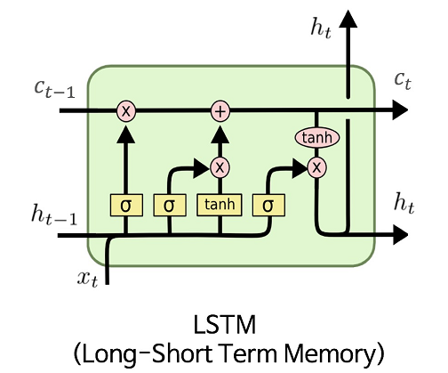
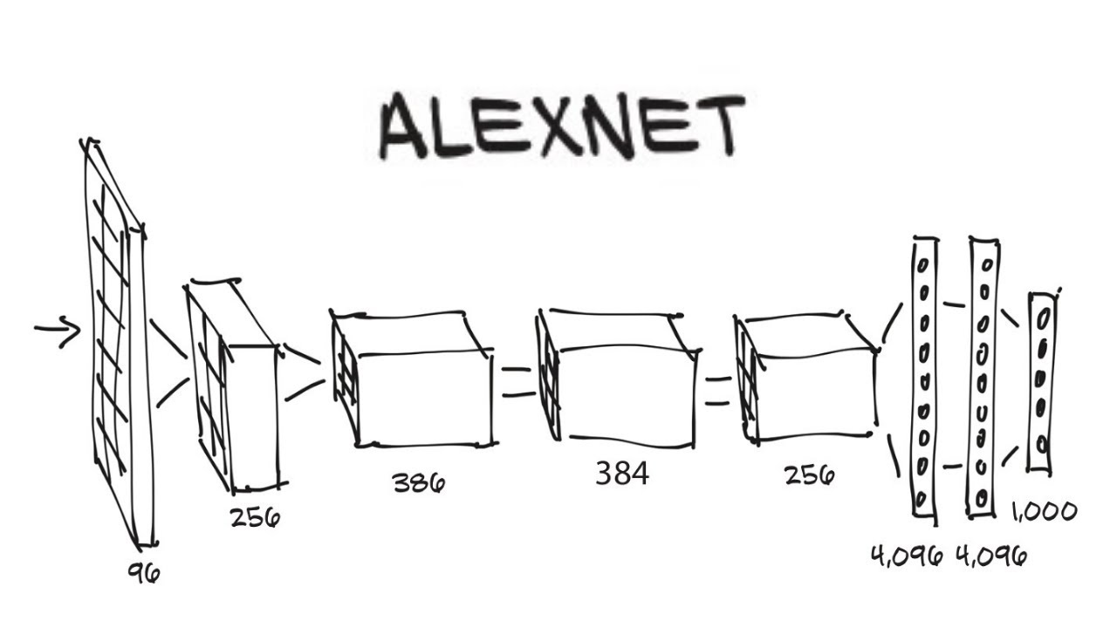
Deep Learning so far…
We are in 2023 – the past 15+ years for AI
Convolution Neural Networks
AlexNet, ImageNet
Recurrent Neural Networks
GRU, LSTM

Slide 3
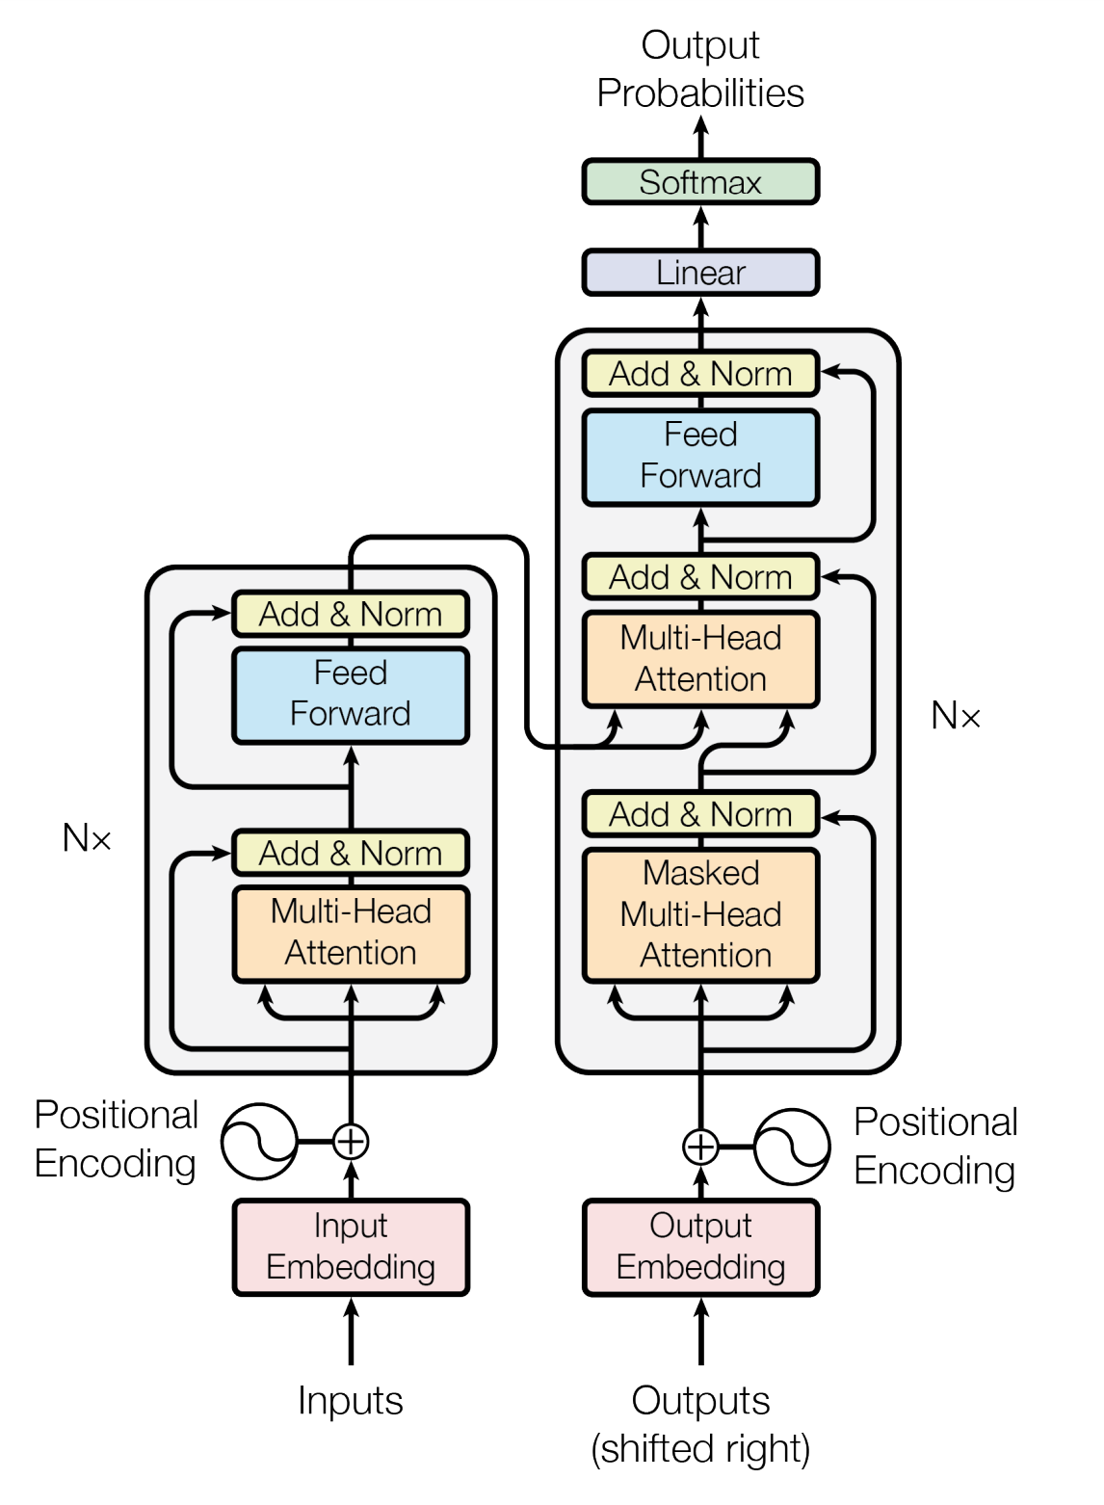
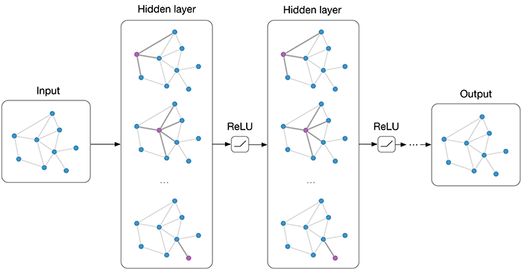
Deep Learning so far…
We are in 2023 – the past 15+ years for AI
Convolution Neural Networks
AlexNet, ImageNet
Recurrent Neural Networks
Graph Neural Networks
GAT, GCN, GNN, etc
Transformers
BERT, GPT, BART, etc

Slide 4
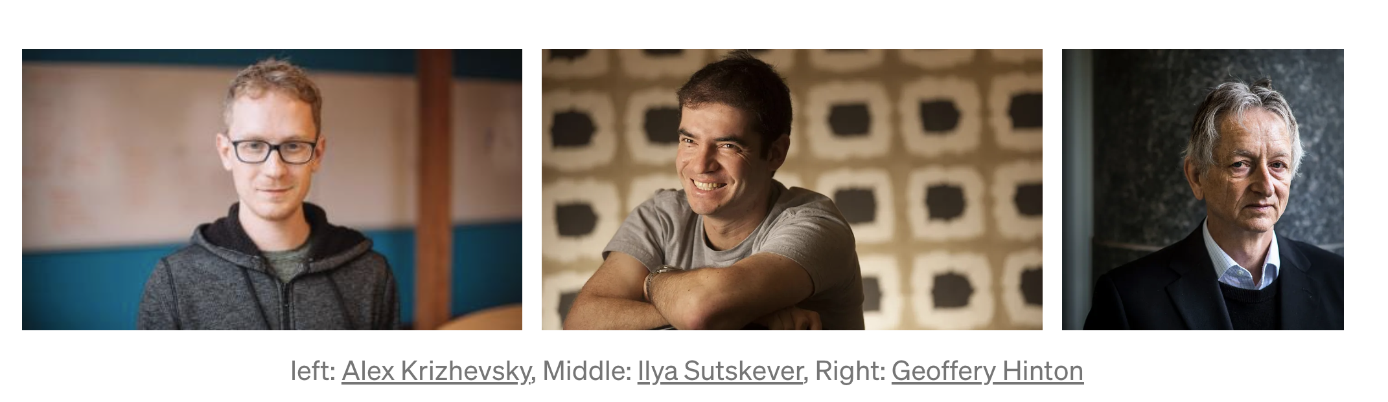
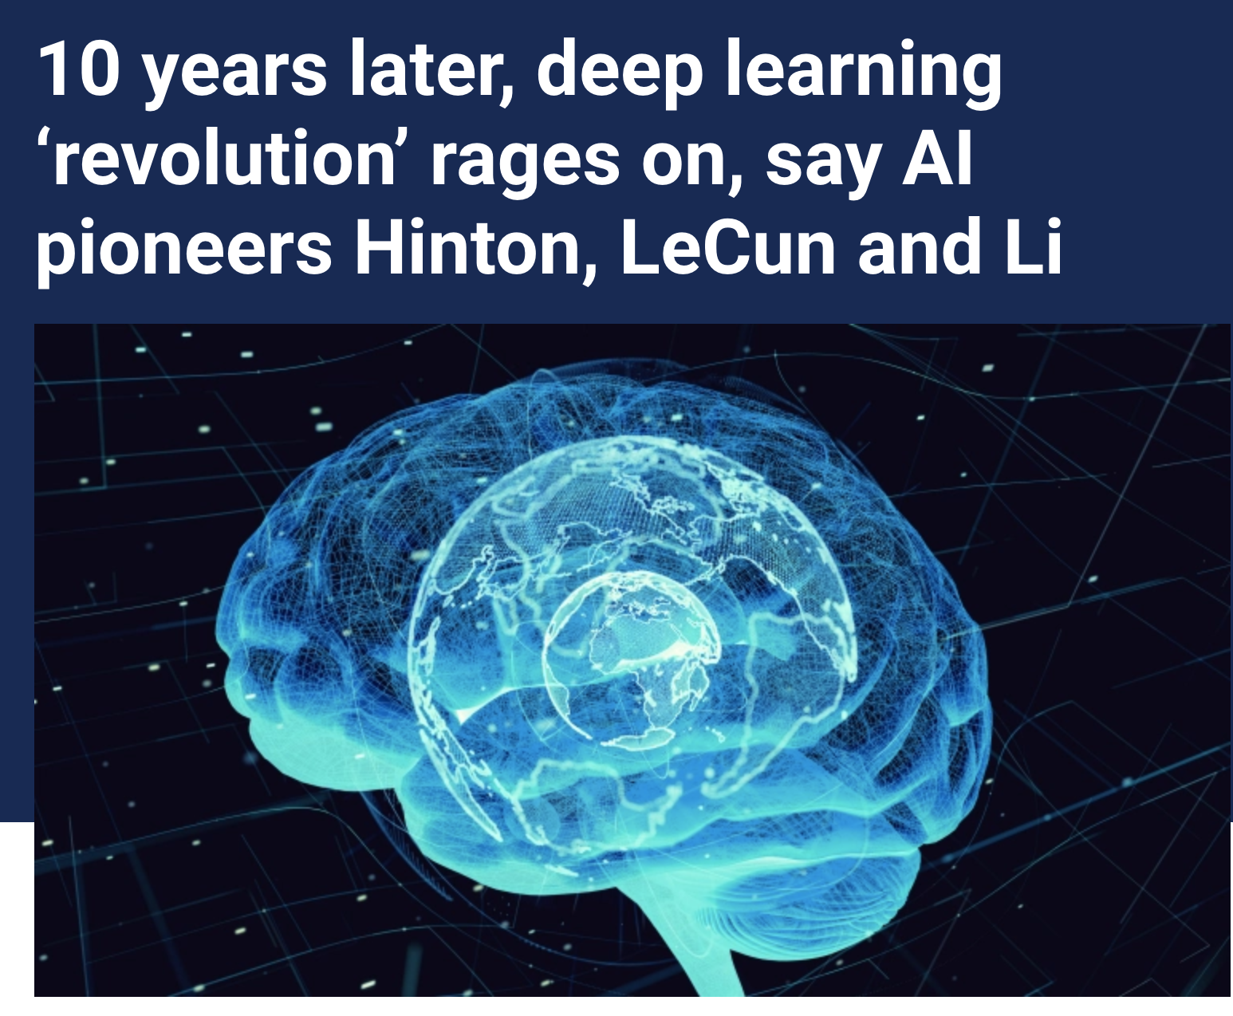


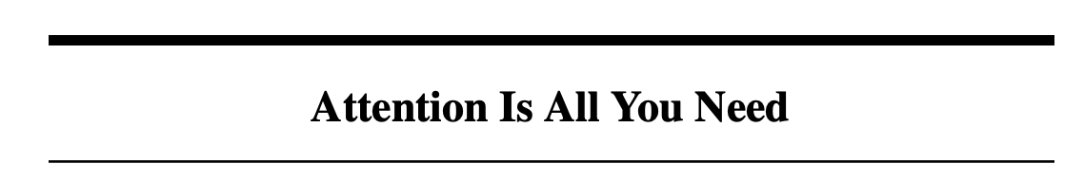
Deep Learning so far…
: Graph is all you need

Slide 5
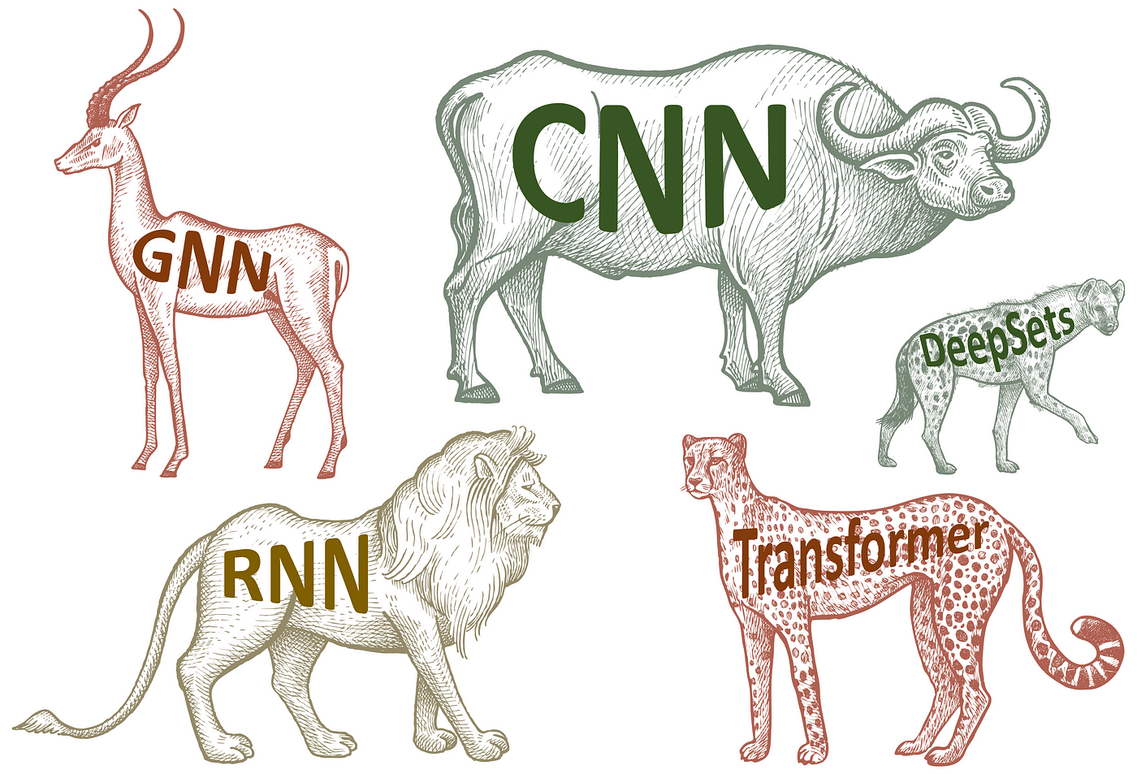
The Best Architecture?

Slide 6
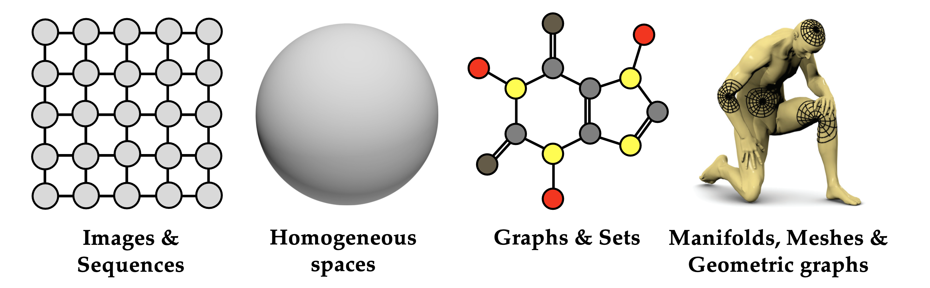
The Best Architecture?
The Domain of the problem, or, the Geometry
The assumption of geometry is INDUCTIVE BIAS

Slide 7
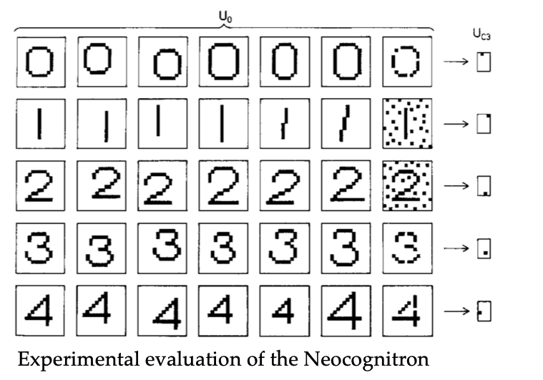
The Best Architecture?
Examples:
Image Data should be processed independently of Shifts (Scaling, Distortions)

Slide 8
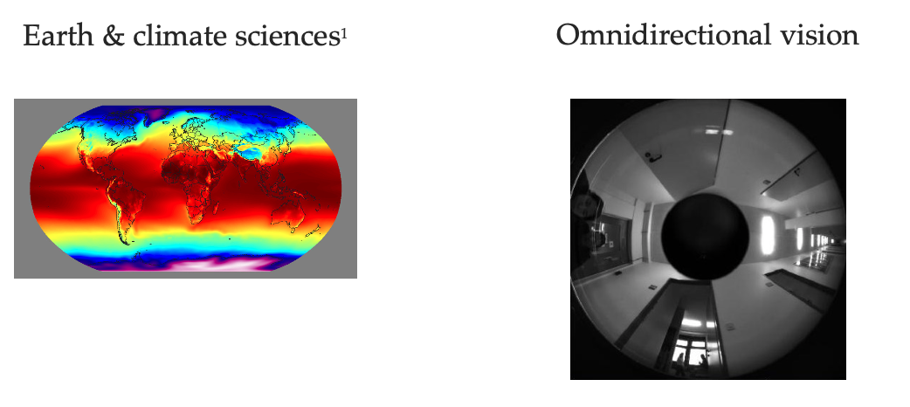
The Best Architecture?
Examples:
Image Data should be processed independently of Shifts (Scaling, Distortions)
Spherical Data should be processed independently of Rotations

Slide 9
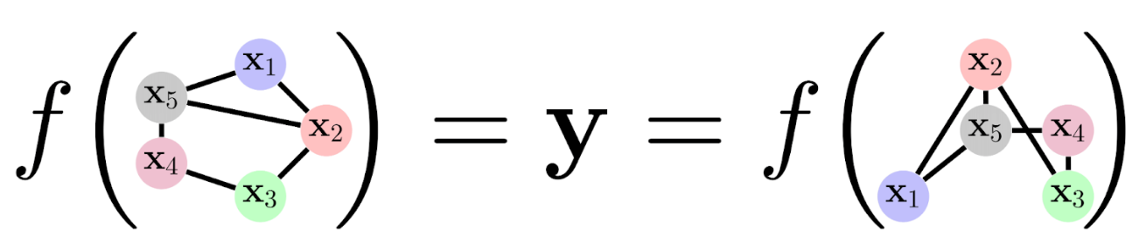
The Best Architecture?
Examples:
Image Data should be processed independently of Shifts (Scaling, Distortions)
Spherical Data should be processed independently of Rotations
Graph Data should be processed independently of Isomorphism (permutation)

Slide 10
Is there a unified framework?

Slide 11
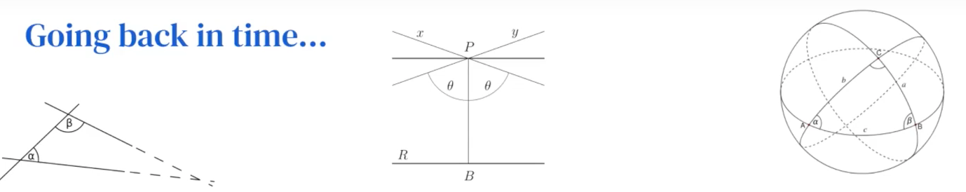
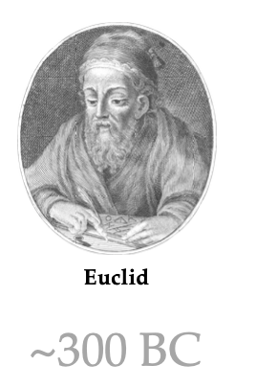
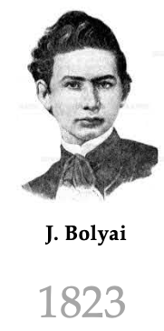
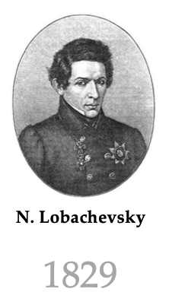
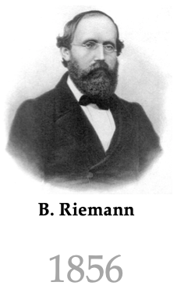
Yes, Geometry!

Slide 12
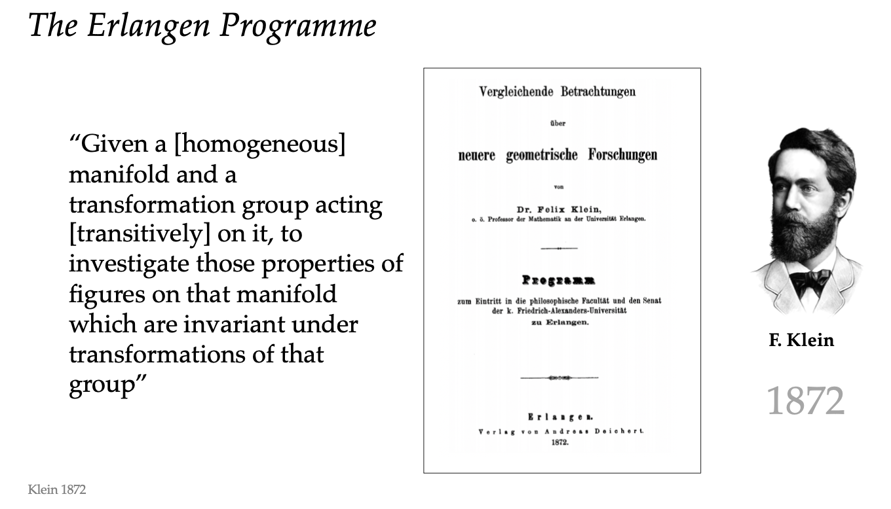
The True Geometry?

Slide 13
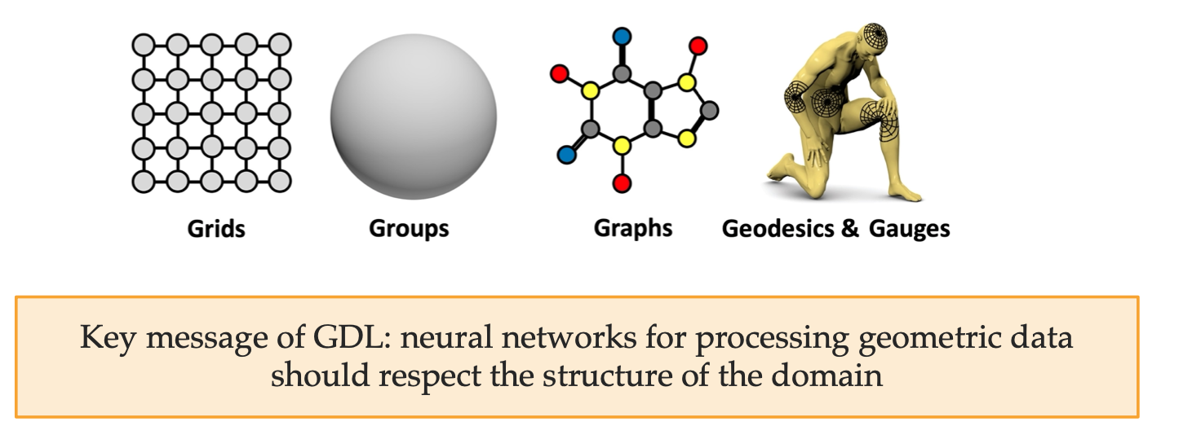

Geometric Domains
The data lives on a domain
The domain $Ω$ has a geometric structure

Slide 14
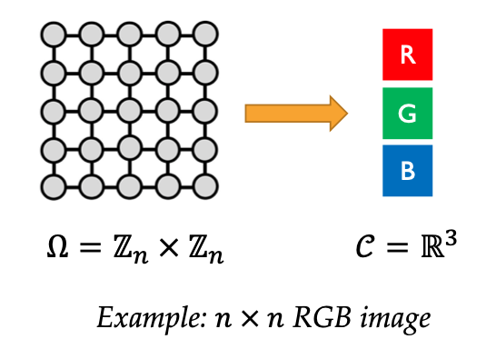
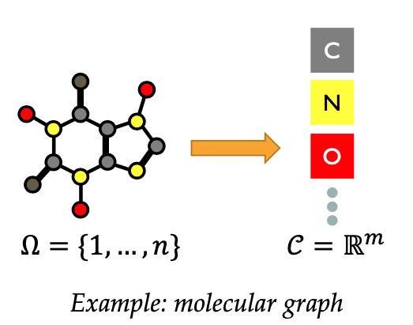
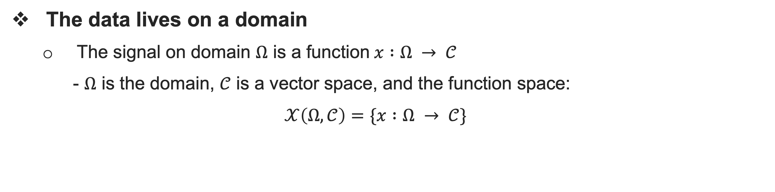
Geometric Domains
The data lives on a domain
The signal on domain $Ω$ is a function $x :Ω → 𝒞$
- $Ω$ is the domain, $𝒞$ is a vector space, and the function space:
$$𝒳\left(Ω,𝒞\right)=\{x :Ω → 𝒞\}$$

Slide 15
Geometric Domains
The data is the domain (No signals)
Meshes, graphs without node
Point Clouds
Solutions
Adjacency matrix
Labels can be used to obtain embedding
But how?

Slide 16
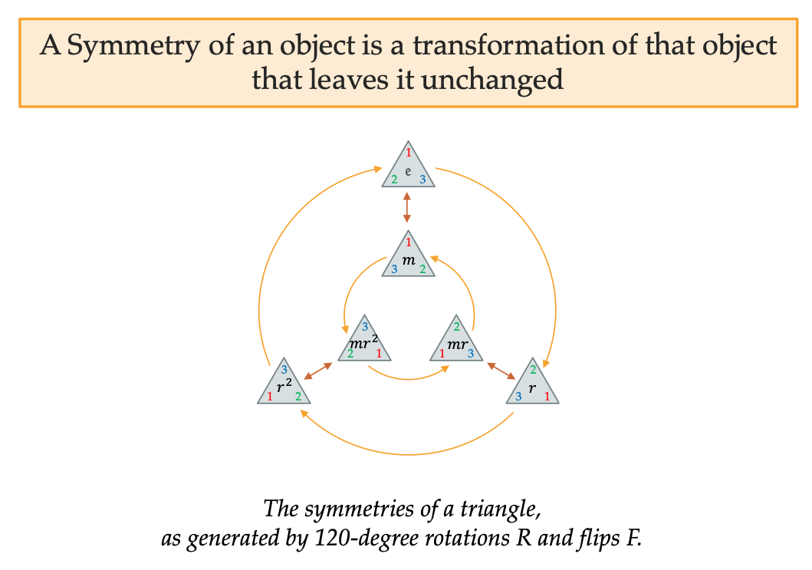
Symmetry

Slide 17
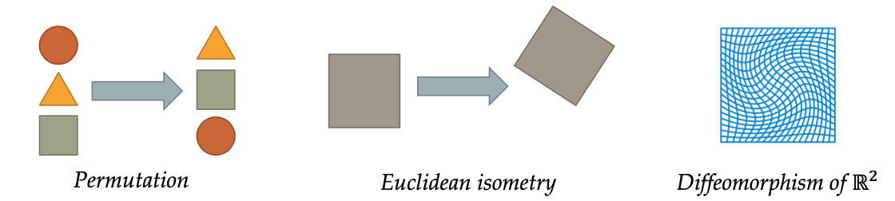
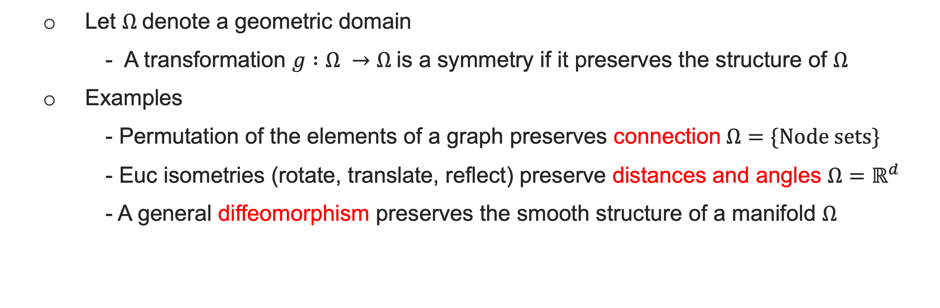
Symmetries of Structured Domains
Let $Ω$denote a geometric domain
- A transformation $g :Ω →Ω$is a symmetry if it preserves the structure of $Ω$
Examples
- Permutation of the elements of a graph preserves connection $Ω=\{Node sets\}$
- Euc isometries (rotate, translate, reflect) preserve distances and angles $Ω=ℝ^{d}$
- A general diffeomorphism preserves the smooth structure of a manifold $Ω$

Slide 18
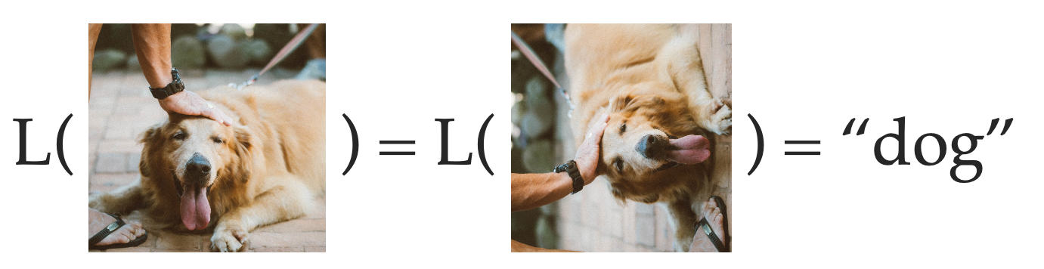
Capturing Symmetries
The Ultimate Goal of Deep Learning – Learning Classes/Labels/Values
Learning classes ≅ Learning Symmetries
≅ Learning functions invariant to group actions
Any map respecting the class boundaries is a symmetry
If we knew all the symmetries of L, we only need one label per class!

Slide 19
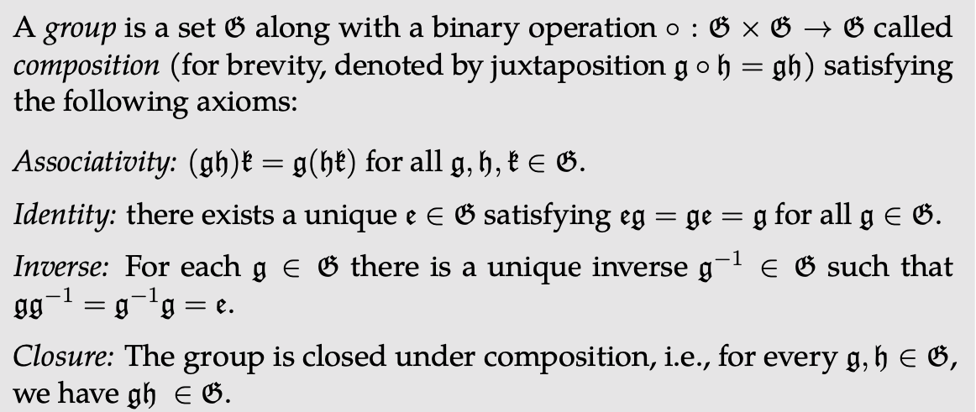
Groups of Symmetries
Symmetry Group
The collection of all symmetries of a given object is called a symmetry group
Key Observation
T
G
G

Slide 20
Groups of Symmetries
Symmetry Group
The collection of all symmetries of a given object is called a symmetry group
Key Observation
The identity transformation is always a symmetry
Given two symmetry transformations, their composition (doing one after the other) is also a symmetry
Given any symmetry, its inverse is also a symmetry

Slide 21
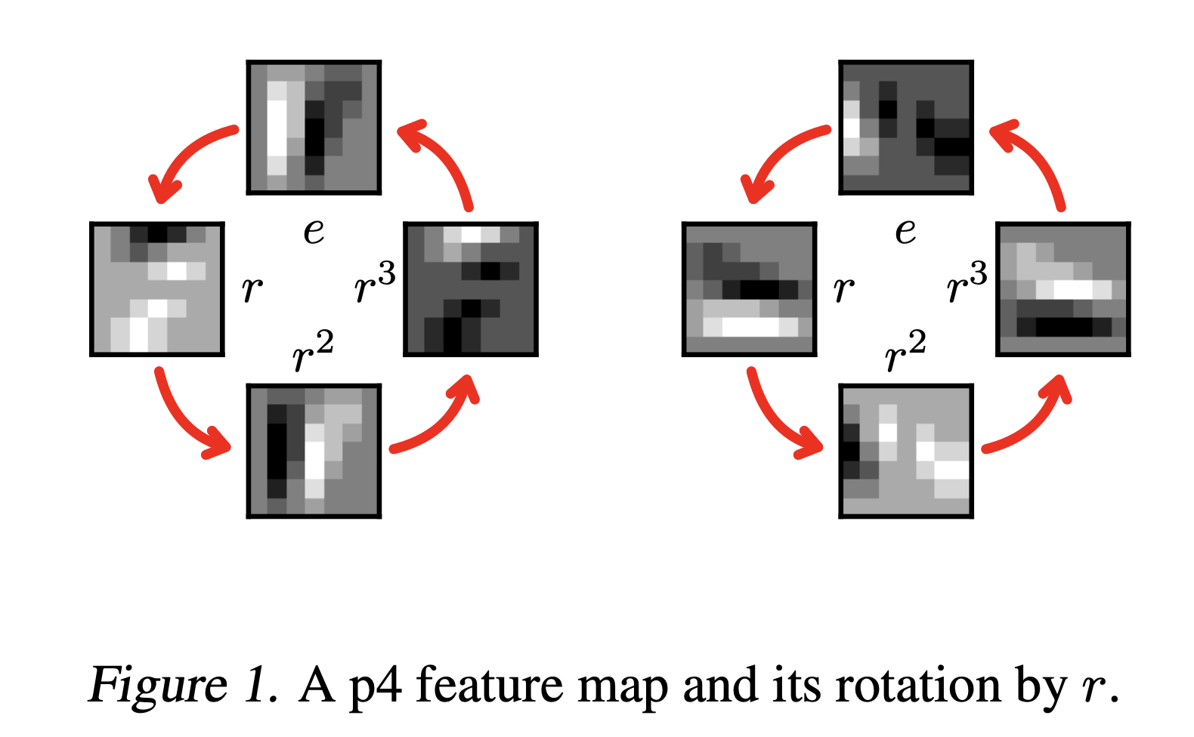
Groups of Symmetries
Symmetry Group
The collection of all symmetries of a given object is called a symmetry group
Key Observation
The identity transformation is always a symmetry
Given two symmetry transformations, their composition (doing one after the other) is also a symmetry
Given any symmetry, its inverse is also a symmetry

Slide 22

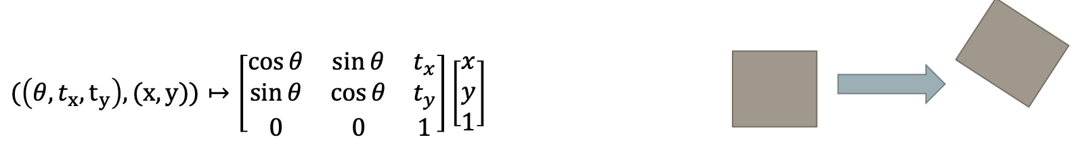
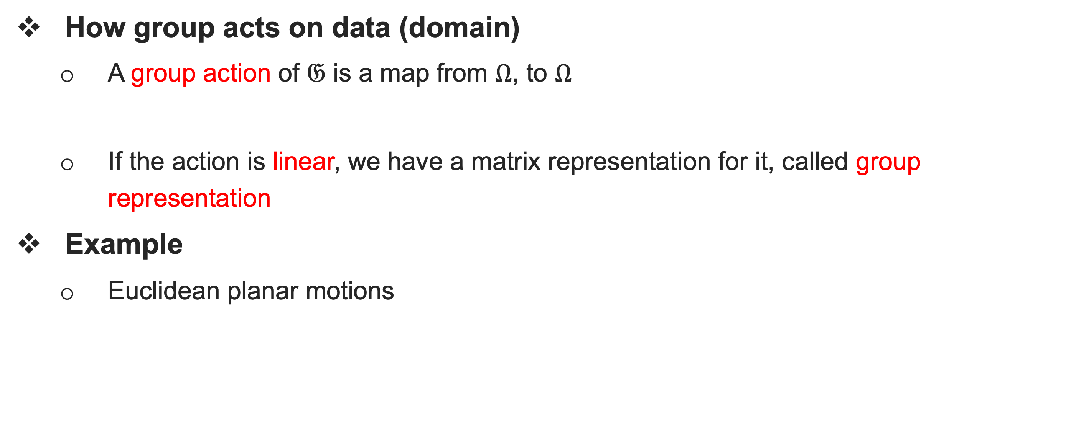
Group Representation (Actions)
How group acts on data (domain)
A group action of $𝔊$ is a map from $Ω$, to $Ω$
If the action is linear, we have a matrix representation for it, called group representation
Example
Euclidean planar motions

Slide 23
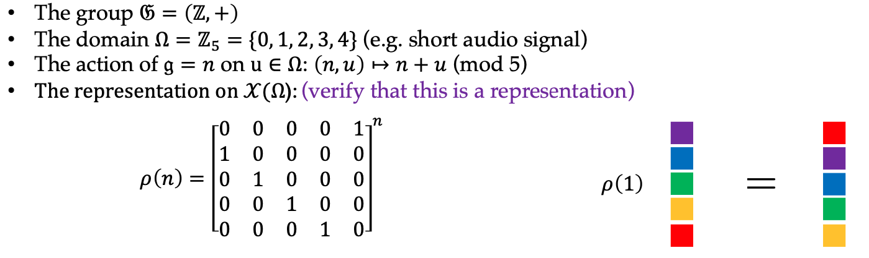
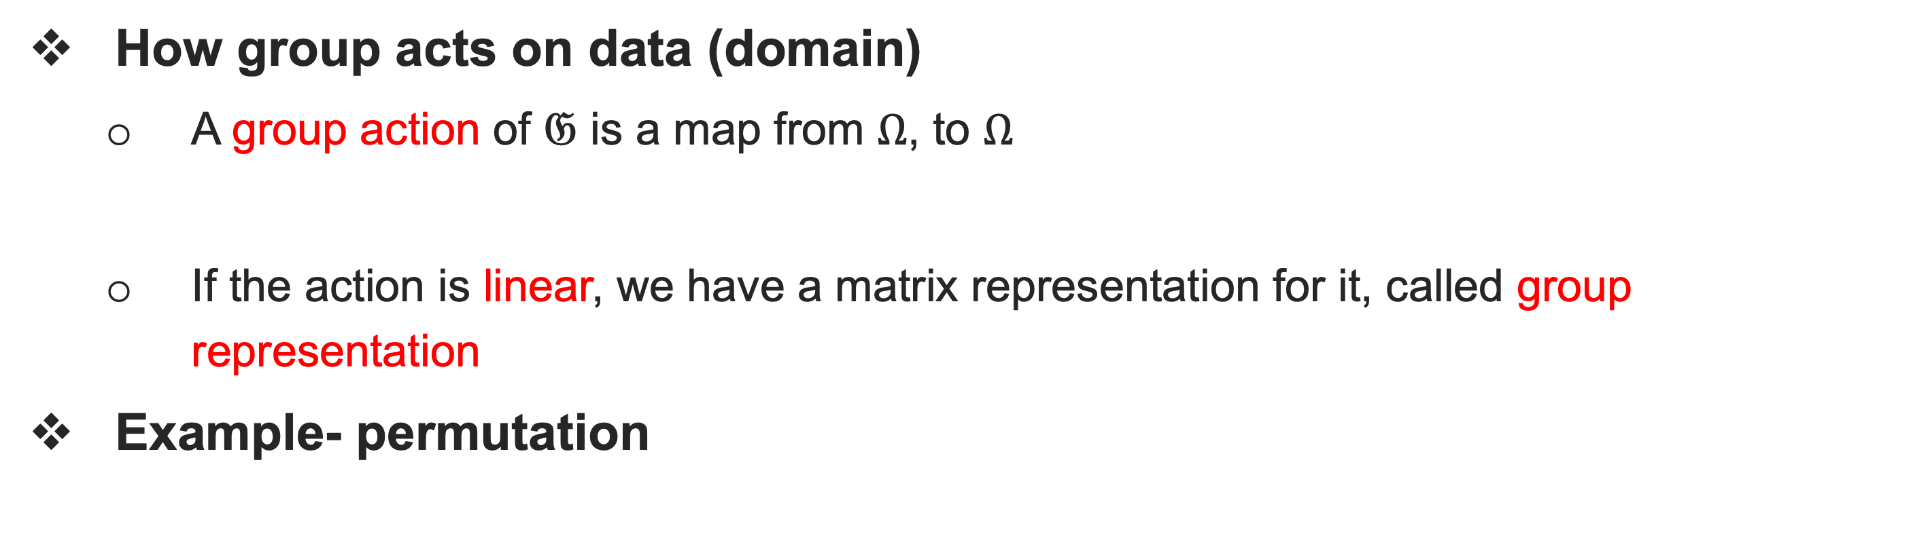
Group Representation (Actions)
How group acts on data (domain)
A group action of $𝔊$ is a map from $Ω$, to $Ω$
If the action is linear, we have a matrix representation for it, called group representation
Example- permutation

Slide 24
How to preserve symmetry in ML?

Slide 25
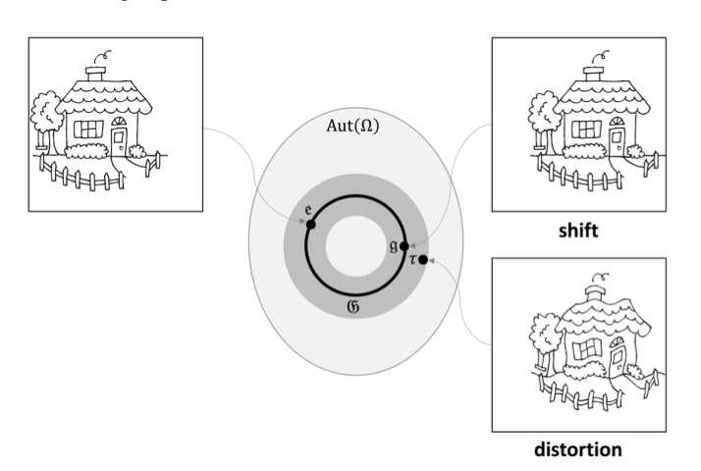
Capturing Symmetries
Data Augmentation?
Sometimes works… But computational Inefficient
Many problems, e.g. Curse of dimensionality, continuous symmetry

Slide 26
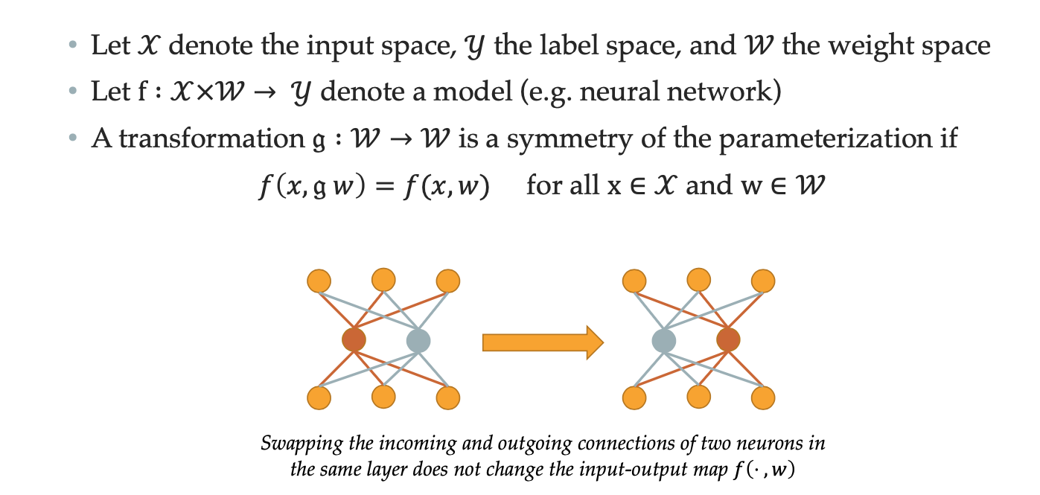
Capturing Symmetries
Design symmetries in the neural networks
Works! And widely used! … Known as Inductive bias, or Function Regularity

Slide 27
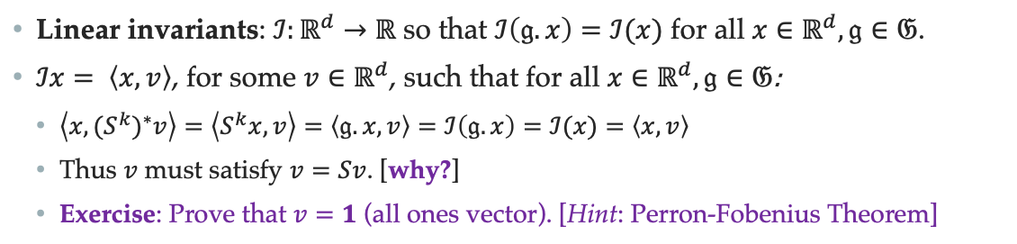
Symmetries Invariants
Linear Invariants
The only linear invariant operator – average/sum
Proof in a nutshell
We have non-linear invariants, max, min etc, but not sufficient!

Slide 28
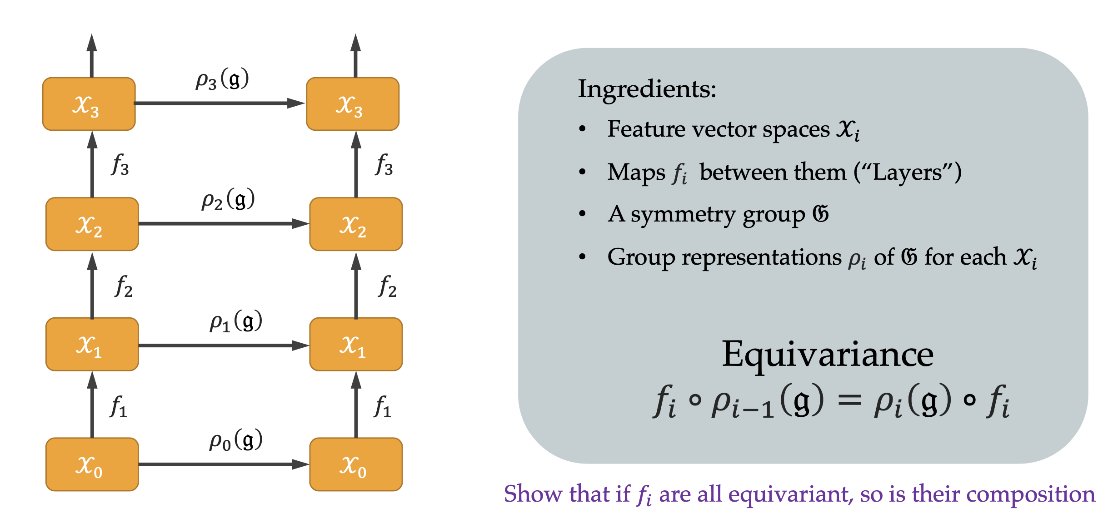
Equivariants + Invariants
Linear Equivariants

Slide 29
Equivariants + Invariants
Linear Equivariants
Key observation
Linear equivariant + linear invariant = linear invariant, does not work
Solution:
Linear equivariant + Local non-linear activation + Linear Invariant
= Expressive Invariant!

Slide 30
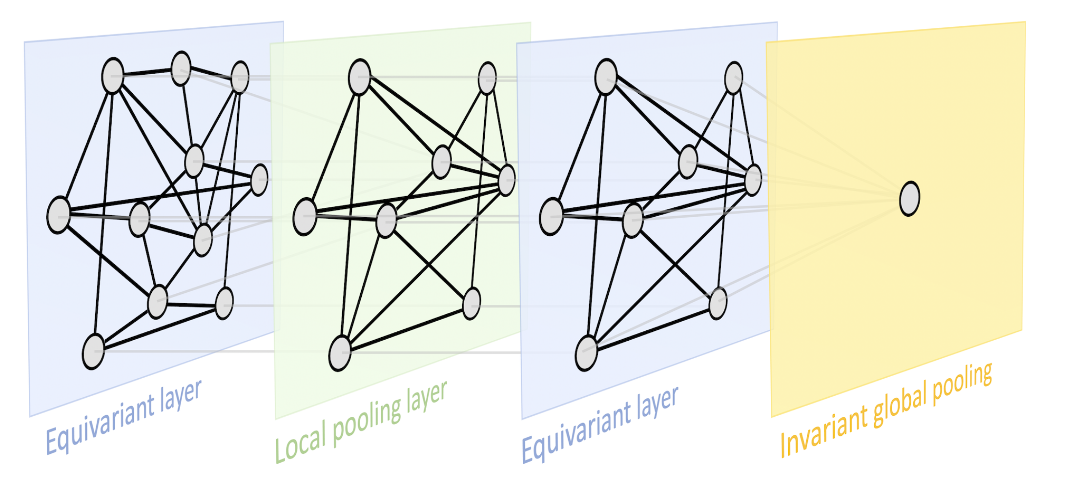
The Blueprint for GDL
Linear equivariant + local non-linear activation + Linear Invariant
= expressive invariant!

Slide 31
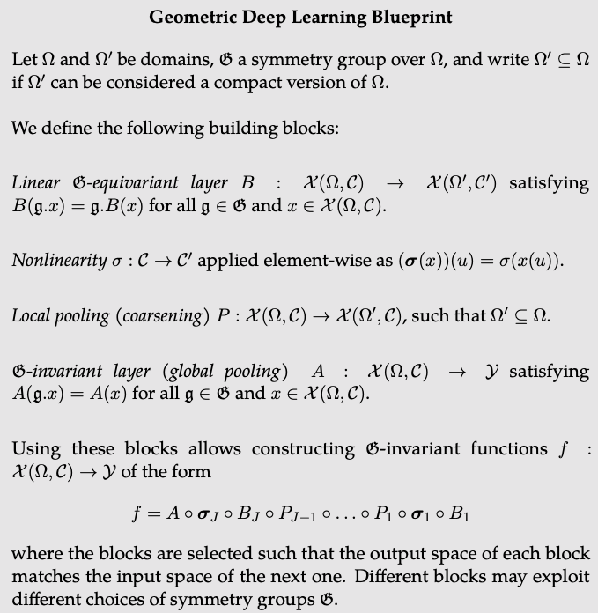
The Blueprint for GDL

Slide 32
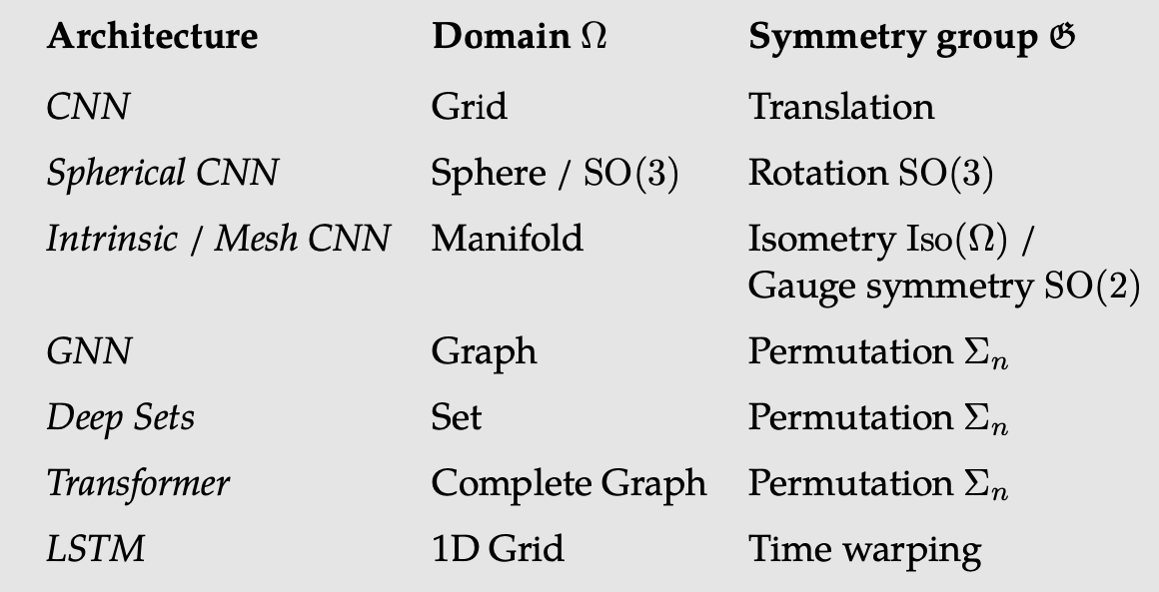
The Blueprint for GDL

Slide 33
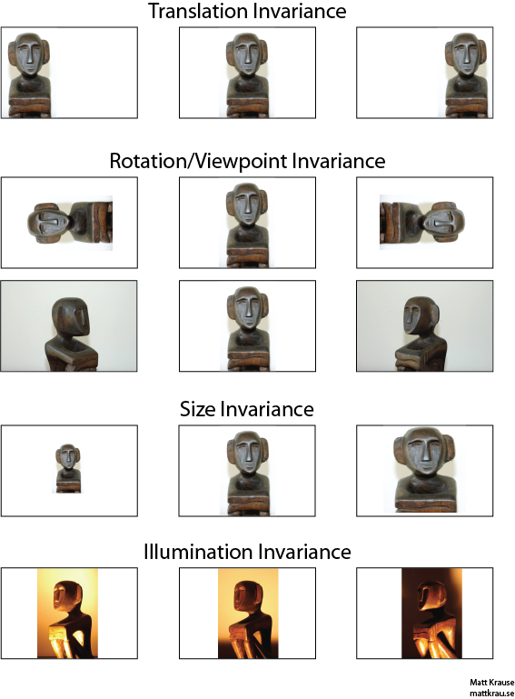
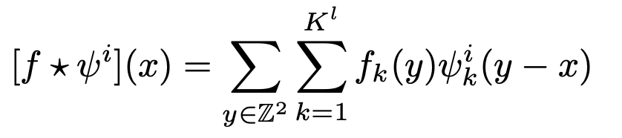
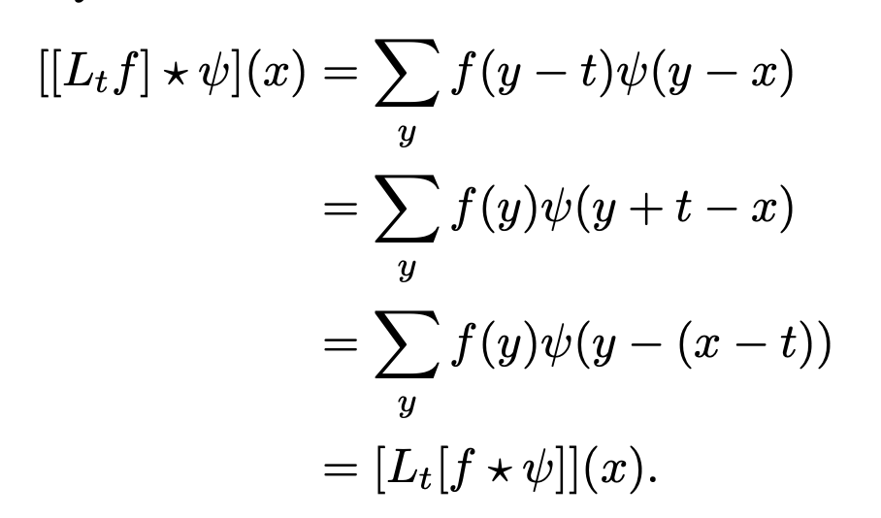
The Blueprint for GDL
Example - CNN
Convolution
The Equivariance of Translational Group
The invariance: pooling

Slide 34
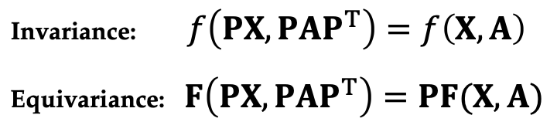
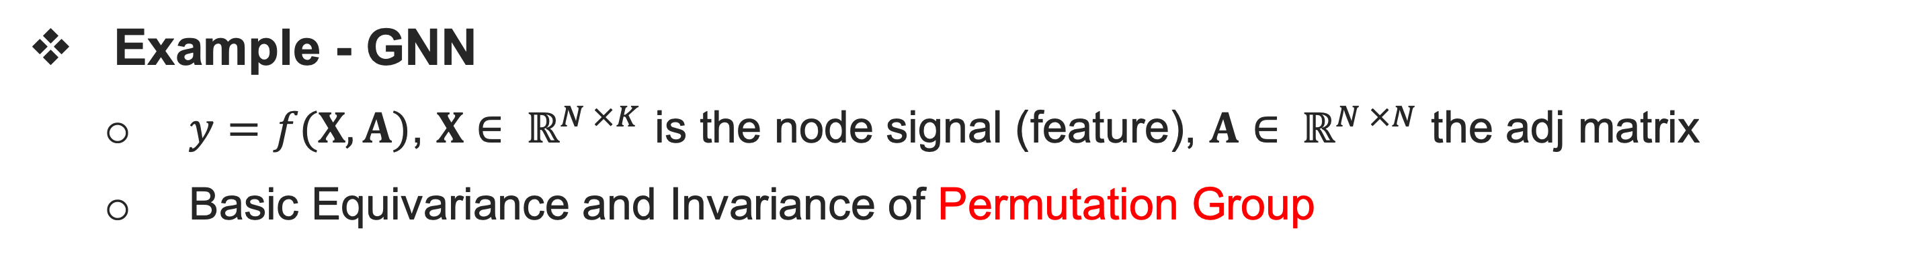
The Blueprint for GDL
Example - GNN
$y=f(X, A)$, $X∈ ℝ^{N ×K}$ is the node signal (feature), $A∈ ℝ^{N ×N}$ the adj matrix
Basic Equivariance and Invariance of Permutation Group

Slide 35
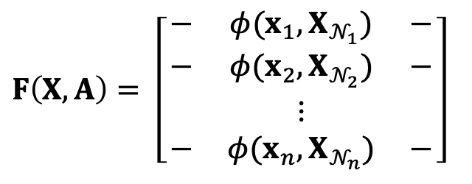
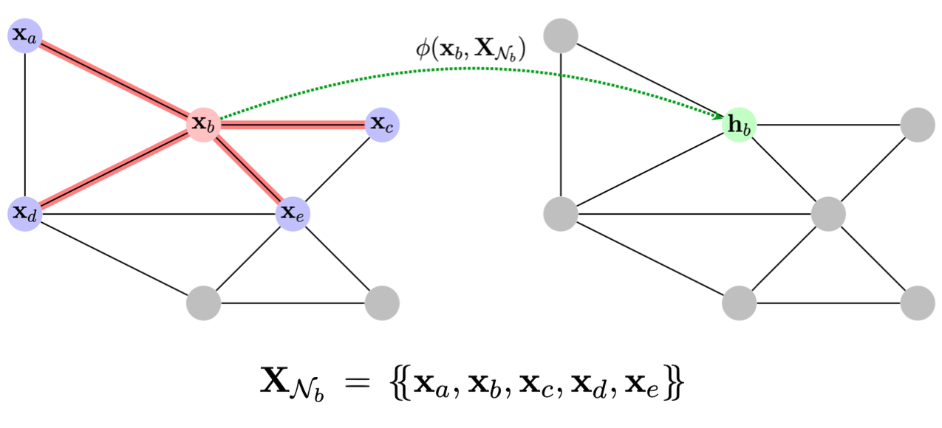
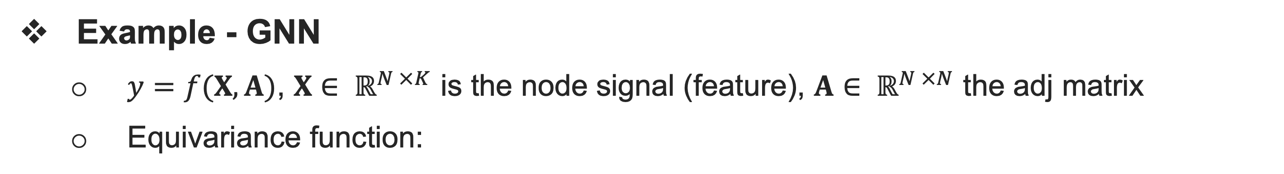
The Blueprint for GDL
Example - GNN
$y=f(X, A)$, $X∈ ℝ^{N ×K}$ is the node signal (feature), $A∈ ℝ^{N ×N}$ the adj matrix
Equivariance function:

Slide 36
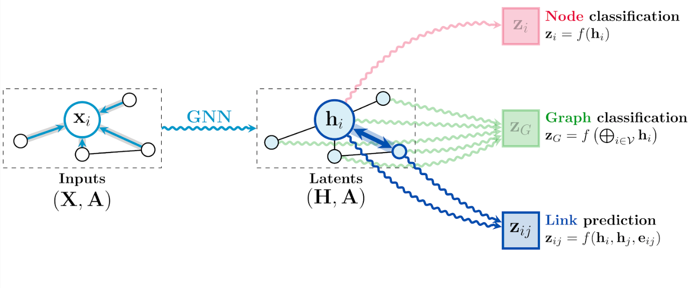
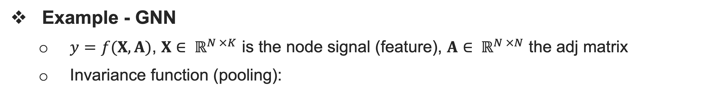
The Blueprint for GDL
Example - GNN
$y=f(X, A)$, $X∈ ℝ^{N ×K}$ is the node signal (feature), $A∈ ℝ^{N ×N}$ the adj matrix
Invariance function (pooling):

Slide 37
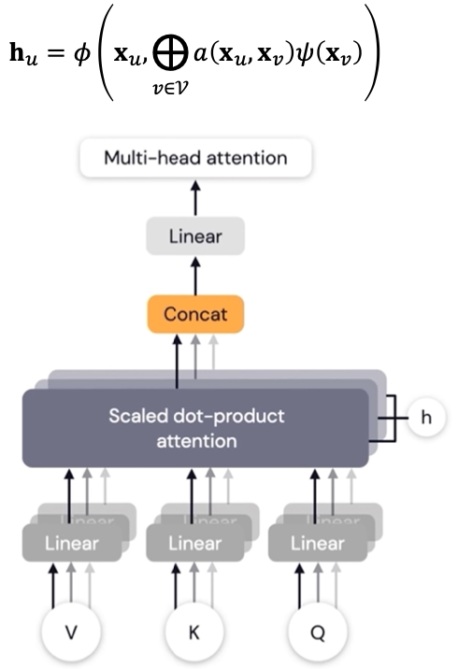
The Blueprint for GDL
Example - Transformer
Well, Pedro has already said it’s a GNN
Equivariant: Cross-attention
Invariance: pooling

Slide 38
This is simple, why need group?

Slide 39

In ICML 2016 reviewer:

Slide 40
One step further..
Groups not being considered
In CNNs
- Rotation, scaling, illumination
In Graph NNs
- Axis rotations in molecule graphs
- Point cloud rotation
Groups that cannot even be processed
360-degree Sphere data

Slide 41

Taco resoundingly dispelled all skepticism

Slide 42

Solutions – Group Convolution

Slide 43


Spherical & SO(3) Convolution

Slide 44
Many other more
Fiber bank for better group-equivariant filter
Steerable CNNs [T. Cohen, et al., ICLR 2017]
Rotation - equivariant on Graphs
E(n) Equivariant Graph Neural Networks [V. G. Satorras, ICML 2021]
Gauge equivariant on manifolds
GAUGE EQUIVARIANT MESH CNNS [P. Haan, ICLR 2021]
Riemannian Geometry for Graph Neural Networks
Understanding over-squashing and bottlenecks on graphs via curvature [J. Topping, et al. ICLR 2021(Outstanding Nomination)]

Slide 45
Thanks for your attention!

Slide 46

Combinatorial Optimization
Combinatorial Optimization
ChatGPT:

